Slide 1

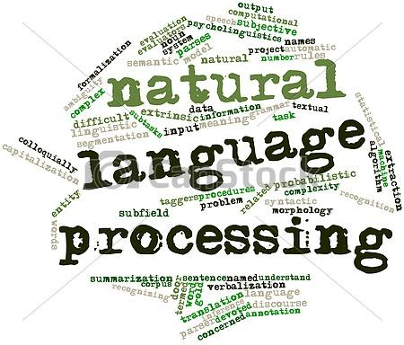
Summer Internship Presentation
(May-July) 2014
Submitted By :
Harshita Jhavar
Final Year CSE Undergraduate
MANIT Bhopal
Under The Guidance Of :
Dr. Pushpak Bhattacharyya
Dr. Manish Srivastava
Notes:
<number>

Slide 2
Presentation Outline
Research Problem Statement
Motivation
Approach
Extension To The Problem Statement
Results
References
Future Scope
Internship Work Timeline
Notes:
<number>

Slide 3
Problem Statement-
“IdentifyingThe Gender Category Of Nouns (Common/Proper) In Hindi Corpus”
Eg. - राम, जो मिठाई बेचता है, आज घर चला गया |
F
M
M
Notes:
<number>

Slide 4
MOTIVATION:
>Gender of proper and common nouns cannot be identified unless they are specifically
assigned a gender in the predefined lexicon list
>It's tedious to make a list of all the existing proper nouns and manually assign
their gender category to them
>Failure of precise morphology analysis of nouns leads to overall decrease in efficiency
of the morphology analyzer techniques and loss of information related to attributes of
existing nouns
Notes:
<number>

Slide 5
Can Gender Category be recognised at Morphology / POS Tagging Level ?
Ending Sound /
Suffix ( If Any )(If Root Form Can Be Identified)
Number
(For Common Nouns)
>>Dependent on the root word list
And suffix replacement rules
>>Ending Sound (Not Always Right)
अ - पुस्तक, छत(f) , घर, हाथ (m )
ई - लड़की (f) , माली (f)
>>Not All nouns have suffixes
>> Word Form Along With Plurals.
लड़का - लड़कें
क्रीड़ा - क्रीडायें
But ऋतु, ओं - feminine
शत्रु, ओं - masculine
>> Also plural to singular is possible but not vice versa
Notes:
<number>

Slide 6
Gender of Proper Nouns / Common Nouns cannot be identified at these levels
with notable efficiency.
Notes:
<number>

Slide 7
Taking The Approach To Next Level Of Chunking And Parsing ----
Sentence = Noun Phrase + Verb Phrase
Nouns- Proper/Common
Main Verb
Pronouns
Auxillary Verb
Adjective
Adverb
Ordinals
Notes:
<number>

Slide 8
Taking The Approach To Next Level Of Chunking And Parsing ----
Sentence = Noun Phrase + Verb Phrase
Nouns- Proper/Common
Main Verb
Pronouns
Auxillary Verb
Adjective
Adverb
Ordinals
--- Categories which change according to gender
Notes:
<number>

Slide 9
Machine was Trained For
Gender Identification Of
Nouns via
Stanford Classifier 3.4
using The Following
Features:-
1.useNGrams=true
1.usePrefixSuffixNGrams=true
1.maxNGramLeng=10
1.minNGramLeng=1
1.binnedLengths=10,20,30
2.useString=true
3.usePrefixSuffixNGrams=true
4.useString=true
5.realValued=true
6.useString=true
7.useString=true
8.useNGrams=true
8.usePrefixSuffixNGrams=true
8.maxNGramLeng=6
8.minNGramLeng=1
9.useString=true
m उत्पादन n NP head 3 _ उत्पादन 0_में sg
_ में psp NP child 1 _ में _ _
_ आई v VGNF head 4 f आ या sg
m गिरावट n NP2 head 17 _ गिरावट 0_का_वजह_से sg
_ की psp NP2 child 4 f का _ _
f वजह n NP2 child 4 _ वजह _ _
_ से psp NP2 child 4 _ से _ _
m गेहूं n NP3 head 10 _ गेहूँ 0_का sg
_ की psp NP3 child 8 f का _ sg
f कीमत n NP4 head 17 _ कीमत 0_में sg
_ में psp NP4 child 10 _ में _ _
m उछाल n NP5 head 14 _ उछाल 0_का sg
_ की psp NP5 child 12 f का _ pl
f आशंकाओं n NP6 head 17 _ आशंका 0_को pl
_ को psp NP6 child 14 _ को _ _
_ खारिज adj JJP head 17 any खारिज _ any
_ करते v VGNF2 head 21 m कर ता_हो+या sg
_ हुए v VGNF2 child 17 m हो या sg
f सरकार n NP7 head 21 _ सरकार 0_ने sg
_ ने psp NP7 child 19 _ ने _ _
_ कहा v VGF head 0 m कह या_है sg
_ है v VGF child 21 any है है sg
_ कि avy CCP head 21 _ कि _ _
_ वर्तमान adj NP8 child 25 any वर्तमान _ any
f जरूरतों n NP8 head 28 _ जरूरत 0_को pl
_ को psp NP8 child 25 _ को _ _
_ पूरा adj JJP2 head 28 m पूरा _ sg
_ करने v VGNN head 37 any कर ना_के_लिए any
_ के psp VGNN child 28 _ के _ _
_ लिए psp VGNN child 28 _ लिए _ _
m देश n NP9 head 37 _ देश 0_में sg
_ में psp NP9 child 31 _ में _ _
m खाद्यान्नों n NP10 head 36 _ खाद्यान्न 0_का pl
_ का psp NP10 child 33 m का _ sg
Notes:
<number>

Slide 10
RESULTS OBTAINED
Corpus Identity | No. Of Lines | Accuracy For Nouns
Hindi Tree Bank – LTRC, IIIT Hyderabad | Training Set Testing Set 12,041 1233 | 74.24%
Random Hindi Corpus (Siva Reddy's (IIIT hyd) Hindi Dependency Parser and POS Tagger ) | 1466 227 | 60.3%
Baseline -
50%
84.32%-Unlabelled
78.92%-Labelled
91.3%
Notes:
<number>

Slide 11
References :
[1]Anshuman Tripathi & Manaal Faruqui : Gender prediction of Indian names.
In Proceedings of the IEEE Students' Technology Symposium (TechSym) 2011,
Kharagpur, India.
[2] Nivre, Joakim, Johan Hall, and Jens Nilsson. "Maltparser: A data-driven
parser-generator for dependency parsing." Proceedings of LREC. Vol. 6. 2006.
[3] Husain, Samar, Prashanth Mannem, Bharat Ram Ambati, and
Phani Gadde. "The ICON-2010 tools contest on Indian language dependency
parsing." Proceedings of ICON-2010 Tools Contest on Indian Language
Dependency Parsing, ICON 10 (2010): 1-8.
[4]Bharati, Akshar, Rajeev Sangal, Dipti Misra Sharma, and Lakshmi Bai.
"Anncorra: Annotating corpora guidelines for pos and chunk annotation for
Indian languages." LTRC-TR31 (2006)
[5] Begum, Rafiya, Samar Husain, Arun Dhwaj, Dipti Misra Sharma,
Lakshmi Bai, and Rajeev Sangal. "Dependency Annotation Scheme for Indian
Languages." In IJCNLP, pp. 721-726. 2008.
Notes:
<number>

Slide 12
Future Scope :
1Sentiment Analysis Can Be Done For Determining The Gender Category Of
Unrelated Nouns Existing In Any Sentence
2 Assignment Of Gender Category via Sonorants
as mentioned in the last referenced paper
3 Efficient Hindi Dependency Parser
Notes:
<number>

Slide 13
Progress Achieved -
Studying Basic Theory
Debugging and Adding Features (Gender, Number) in
Hindi Morphology Analyzer
Solution to Gender of Nouns And Other Categories In Hindi
Final Presentation And Report Submission
Notes:
<number>

Slide 14
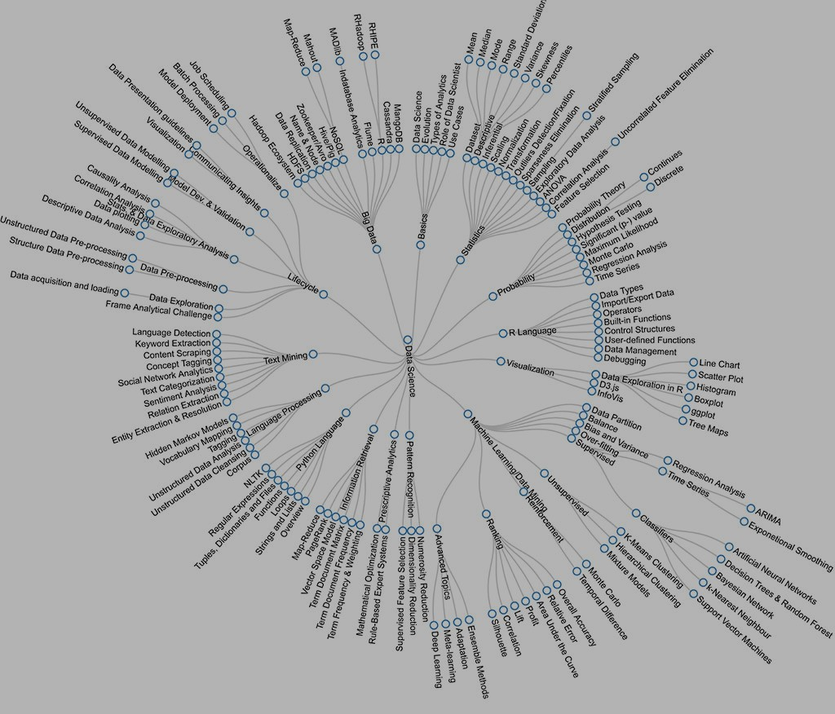
THANKYOU !
Notes:
<number>

